Slide 1
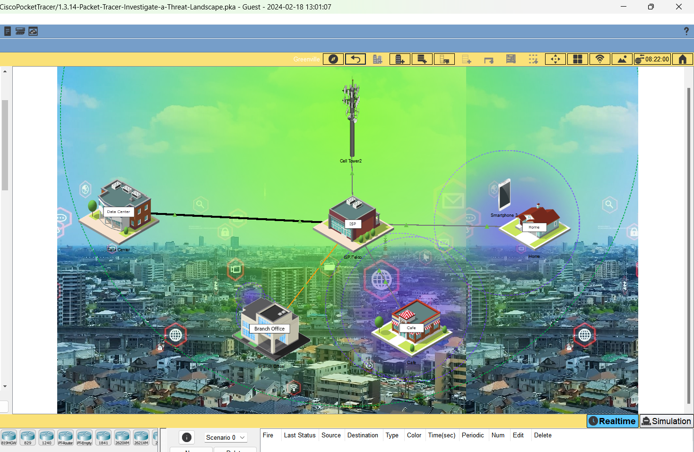
Cisco Packet Tracer: Investigating Three Exploitable Vulnerabilities by Threat Actors

Slide 2
Investigate a Threat Landscape
Objectives:
Investigate a Network Configuration Vulnerability
Investigate a Phishing Malware Vulnerability
Investigate a Wireless Network and DNS Vulnerability

Slide 3
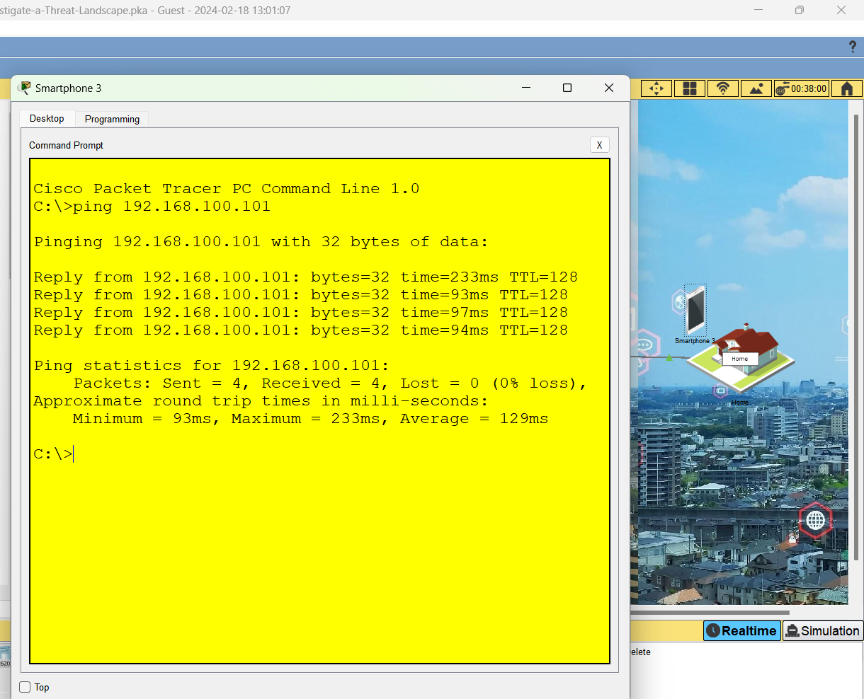
Investigating a Network Configuration Vulnerability
Using a Guest Network to Gain Access to Other Devices: A Two-Step Process
Locate a Smart Phone Outside of the Home Network
On Command Prompt, Ping the IP Address 192.168.100.101

Slide 4
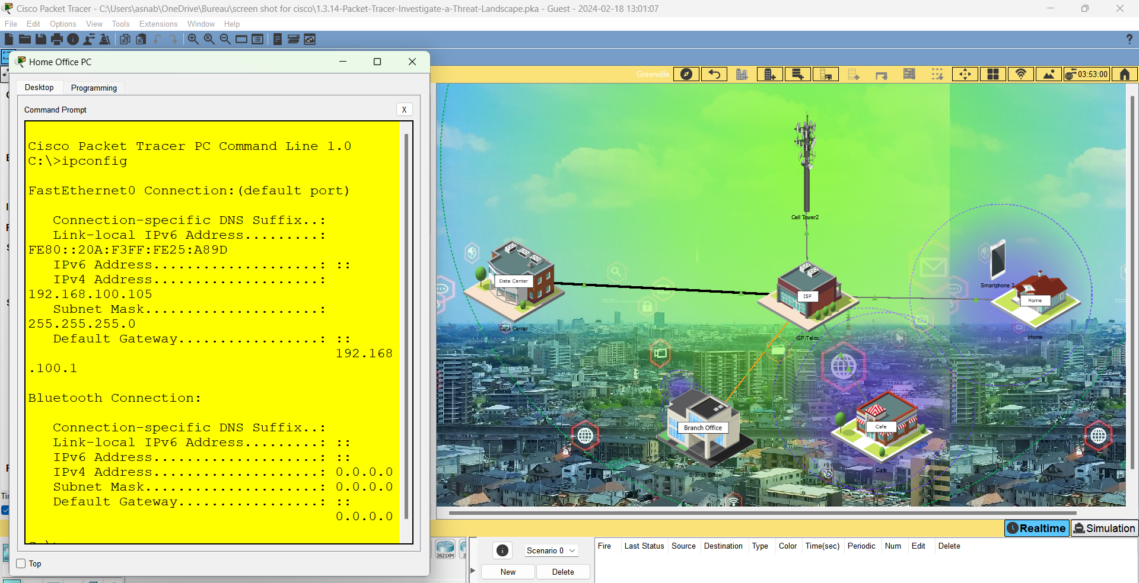
Exploring the Home network to identify the vulnerability
Accessing the Home Office PC
1. Navigate by clicking on Home, then select Home Office PC.
Go to the Desktop tab.
Open Command Prompt.
Identifying the Default Gateway IP Address
2. At the command prompt, enter the command ipconfig.
Locate the Default Gateway to find the IP address of the Home Wireless Router.

Slide 5
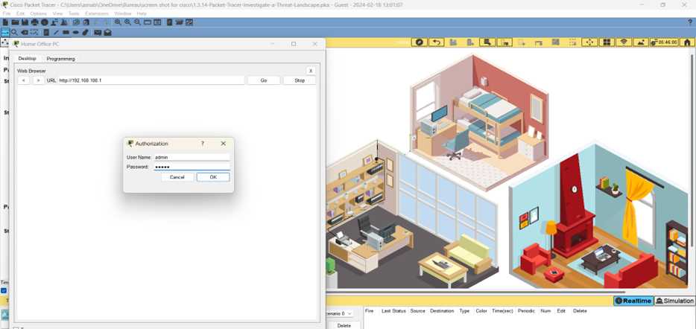
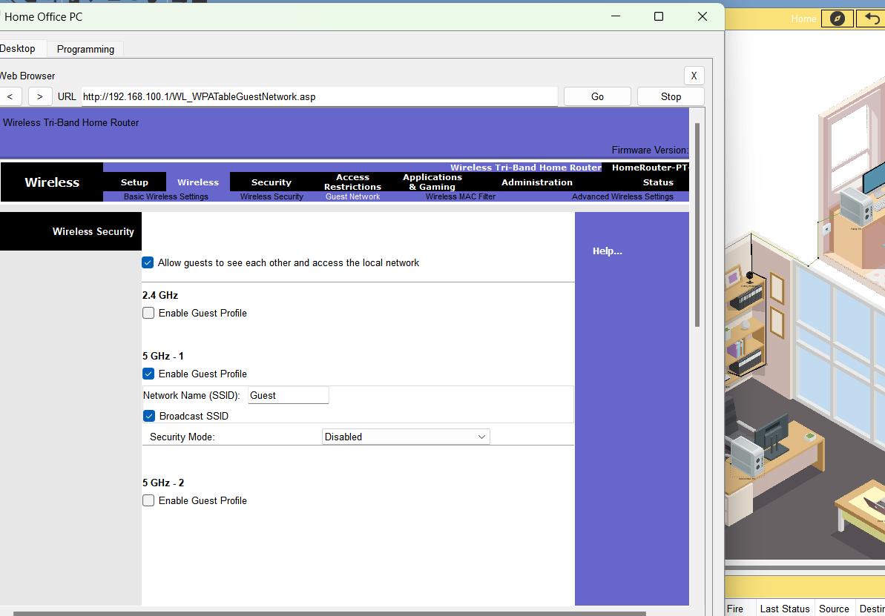
Identifying Vulnerabilities in Home Network Security
.
1. Accessing Router Configuration via Web Browser
Close the Command Prompt.
Open the Web Browser and enter the default gateway IP address.
2. Logging into the Home Wireless Router
Use admin as both the username and password to log in.
3. Inspecting Wireless Security Settings
Navigate to Wireless > Wireless Security.
Examine the Basic Wireless Settings for the three radios in the wireless router.
4. Reviewing Wireless Security Submenu
Select the Wireless Security submenu to review detailed security settings.
5. Investigating Unauthorized Access
Note that Smartphone 3 accessed the network externally without login credentials.
Go to the Guest Network submenu to investigate the security configurations.

Slide 6
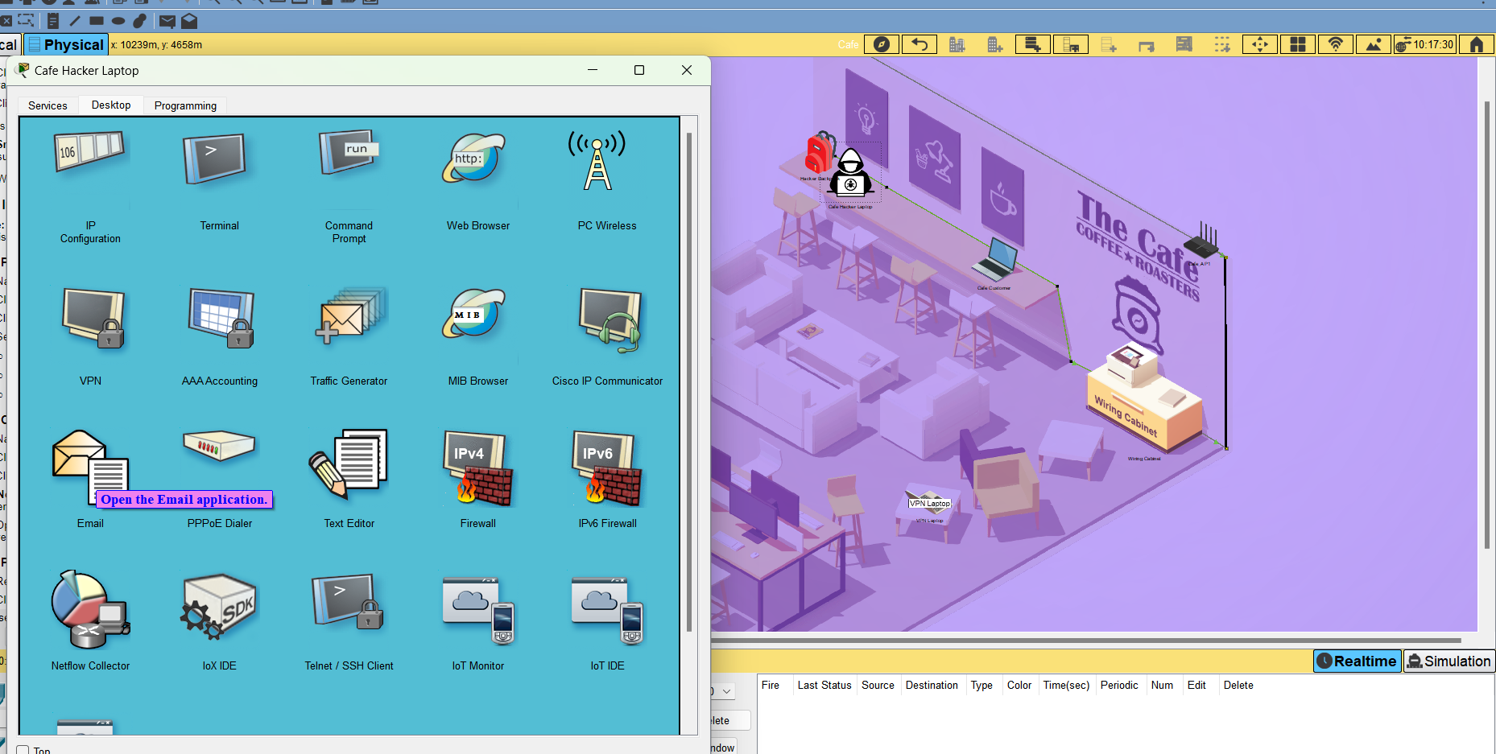
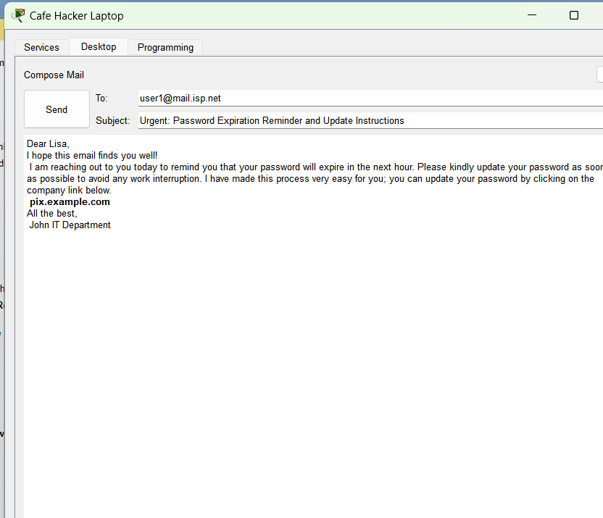
Investigating a Phishing Malware Vulnerability
Simulating a Phishing Attack: Crafting and Sending a Phishing Email
1. Access the Network
Navigate to the Cafe network.
2. Prepare the Phishing Email
Access the Cafe Hacker Laptop and select the Desktop tab.
Open Email application.
3. Compose the Phishing Email
Click Compose to draft a new email.
Creatively write a phishing email that entices recipients to click on the link pix.example.com.
4. Target Email Recipients
Address the email to three individuals within the Branch Office network:
user1@mail.isp.net
user2@mail.isp.net
user3@mail.isp.net
5. Execute the Simulated Attack
Send the email and monitor for any interactions with the phishing link.

Slide 7
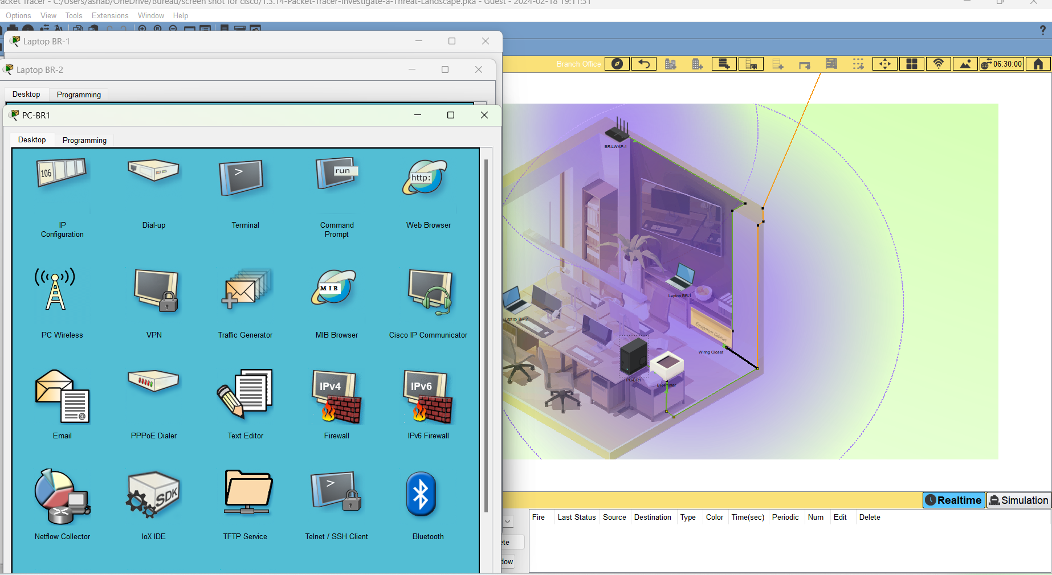
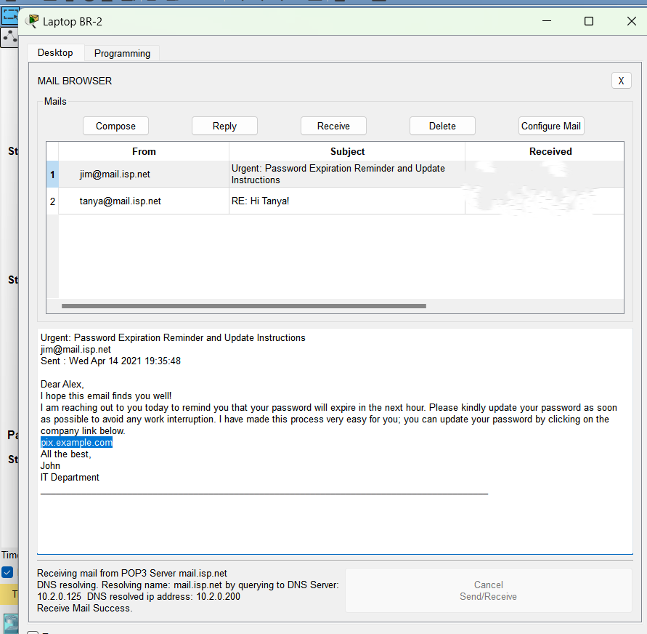
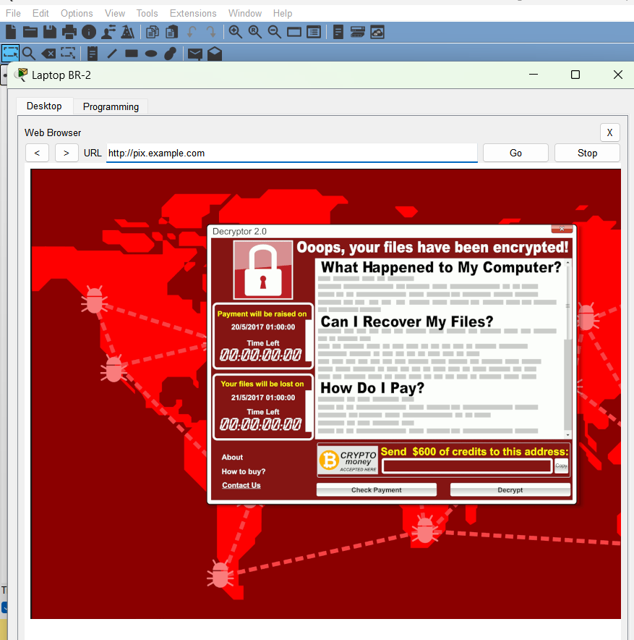
Receiving Emails from the Threat Actor: Verification Process
1. Access the Branch Office Network
Navigate to the Branch Office.
2. Check Emails on Devices
Select one of the devices: PC-BR1, Laptop BR-1, or Laptop BR-2.
3. Open the Email Client
Go to the Desktop tab.
Open Email.
Click Receive to check for new emails.
4. Note on Network Convergence
Be aware that Packet Tracer may require up to a minute to update.
If the email doesn’t appear, click Receive again.
5. Optional: Confirm Email on Other Devices
Visit other potential victim devices.
Open their Email clients.
Click Receive to ensure they have also received the phishing email.
After clicking on the link in the message, the screen locked with a message indicating that this is a ransomware attack.

Slide 8
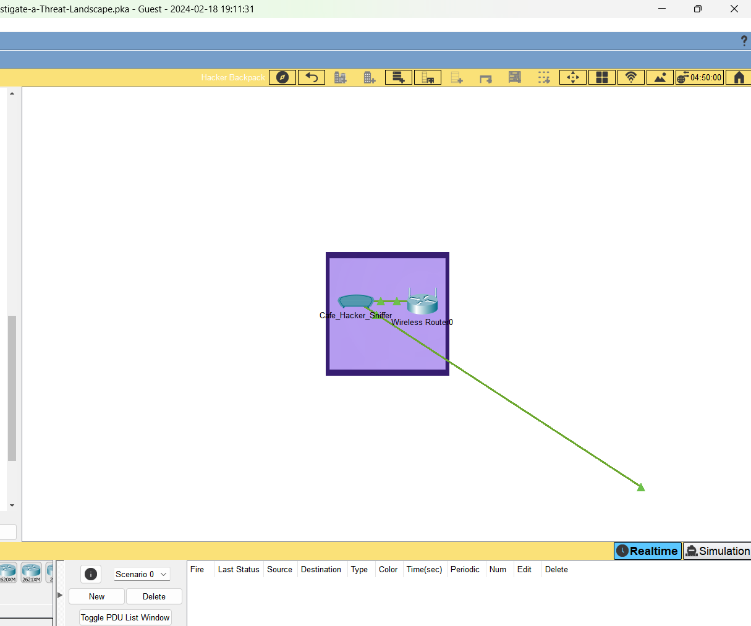
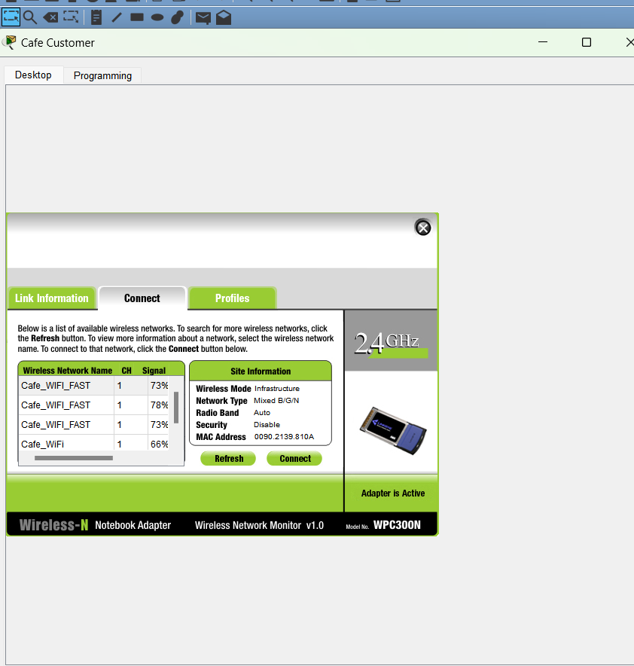
Investigating a Wireless Network and DNS Vulnerability
Connecting to the Threat Actor's Wireless Network
Locate the Threat Actor
  Go to the Cafe.
  Observe the threat actor positioned in the corner.
Examine the Hacker's Equipment
  Select the Hacker Backpack.
  Review the items inside.
Access Wireless Networks
  Return to the Cafe Customer laptop.
  Open the Desktop tab.
  Launch the PC Wireless application.
Establish the Connection
  Navigate to the Connect tab.
  Press Refresh to update the list of networks.
Join the Network
  Choose a Cafe_WI-FI_FAST 78 % network that looks legitimate and has a strong signal.
  Click Connect to join the network.

Slide 9
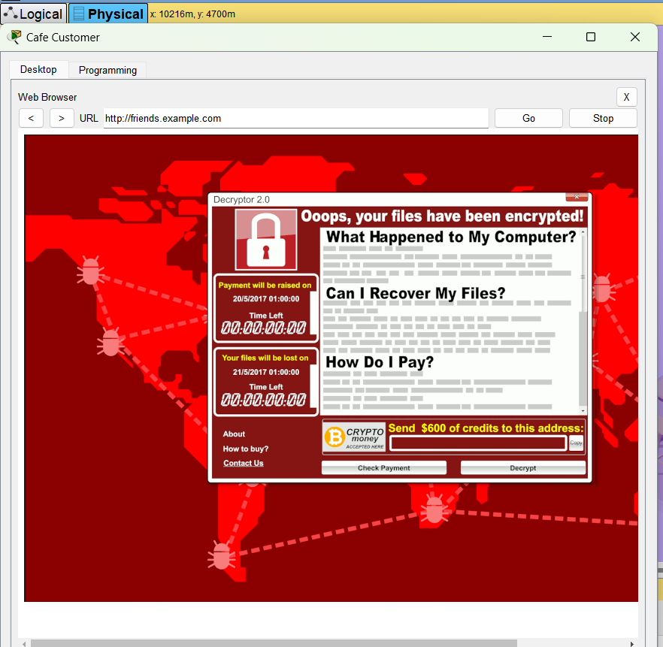
Visiting Your Favorite Social Media Site
1. Exit the Wireless Application
  Close the PC Wireless application.
2. Open the Web Browser
  Click on the Web Browser icon.
3. Navigate to Social Media
  Type friends.example.com into the URL field.
  Press Go to visit the site.
  The URL was friends.example.com; it was taken to the malware server.

Slide 10
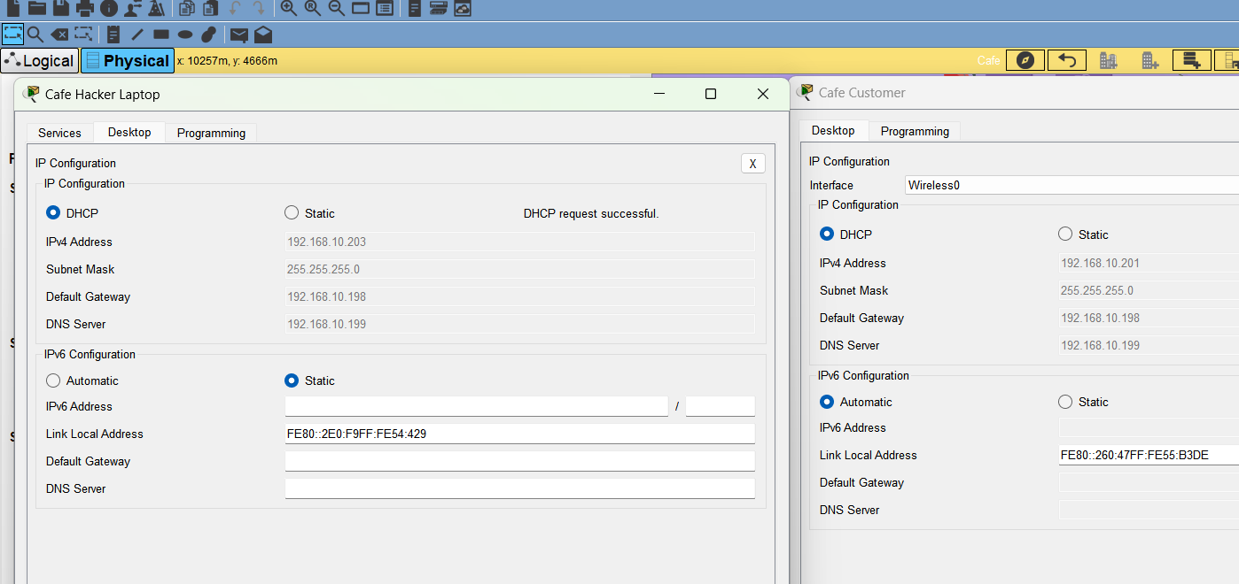
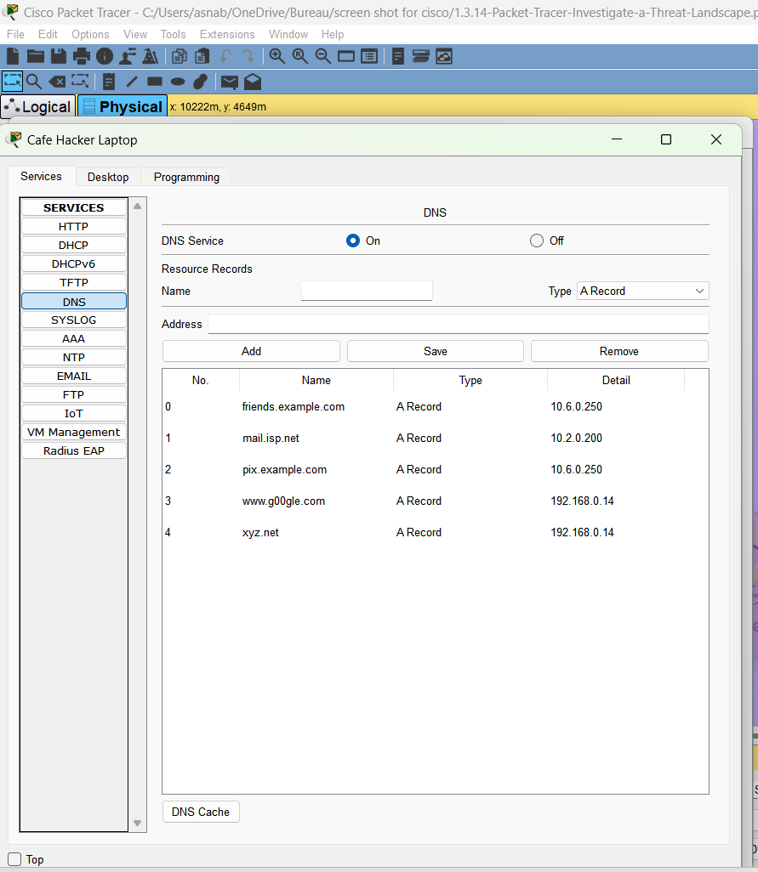
Investigating the Source of the Attack
Access IP Configuration
  Close the Web Browser.
  Click IP Configuration for device settings.
Review VPN Laptop Configuration
  In the Cafe, select VPN Laptop.
  Go to the Desktop tab and open IP Configuration.
Compare Configuration Settings
  Position the two IP Configuration windows side by side.
  Compare the configurations of both devices.
Examine the Hacker's Laptop
  Investigate the Cafe Hacker Laptop.
Check DNS Services
  On the hacker’s laptop, select the Services tab.
  Navigate to DNS.
  Identify the Name entry for friends.example.com.
  Confirm that its IP address matches pix.example.com from the phishing attack.
Review DHCP Services
  Still under Services, select DHCP.
  Observe that the distributed DNS server address matches the one used by the Cafe Customer.
  Notice: the 192.168.10.199. Is it the same as the DNS server address configured on the Cafe Customer laptop.

Slide 11
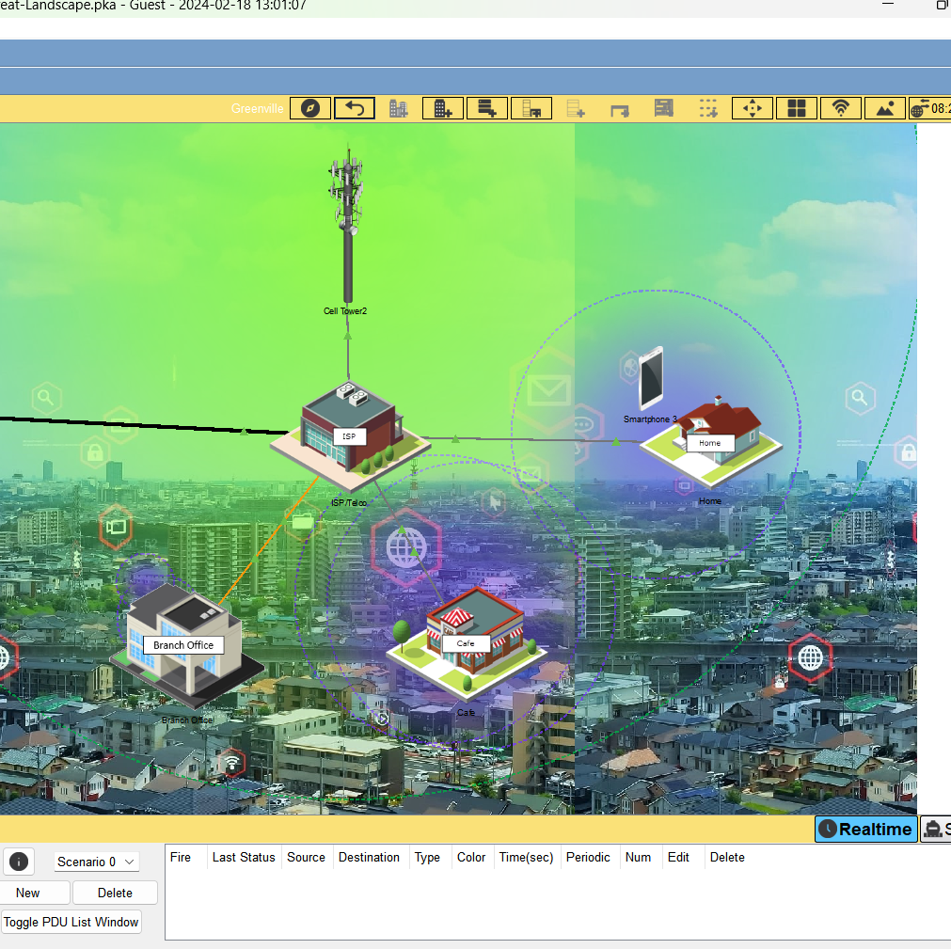
Executive summary
In this activity, we observed how vulnerabilities could be exploited through a sophisticated attack where the Cafe Customer, upon connecting to a rogue wireless network, was assigned an IP configuration by a DHCP server controlled by the attacker. This server misleadingly designated the hacker's laptop as the DNS server, which then rerouted traffic intended for the popular site friends.example.com to a malicious server with the IP address 10.6.0.250. Consequently, when attempting to access the site, the user was unknowingly directed to this server, resulting in ransomware installation on the Cafe Customer’s laptop and the encryption of the user's files. This scenario underscores the importance of recognizing and mitigating vulnerabilities proactively to prevent cyberattacks, highlighting the responsibility of network users and cybersecurity professionals to safeguard against such exploits.

